Slide 1
6.013 Radiolocalization Project
Conducted by Leif Clark, Abigail Shull, and John Paris
Presented by Leif Clark

Slide 2
Fundamental Idea
A conductive object between a transmitting and receiving antenna should divert, reflect, deflect, and obstruct the transmitted signal
The size and location of this conductive object impact the power received over a range of frequencies in a consistent manner
How is this different than radar?
Radar relies on detecting radio waves reflected from the object back to a receiving antenna, often at/near the transmit point, and considers timing
“passive” location relies on detecting how a signal is disrupted between two points at a distance from each other, and relies heavily on considering signals that are missing at the receive point
“passive” location is time agnostic

Slide 3
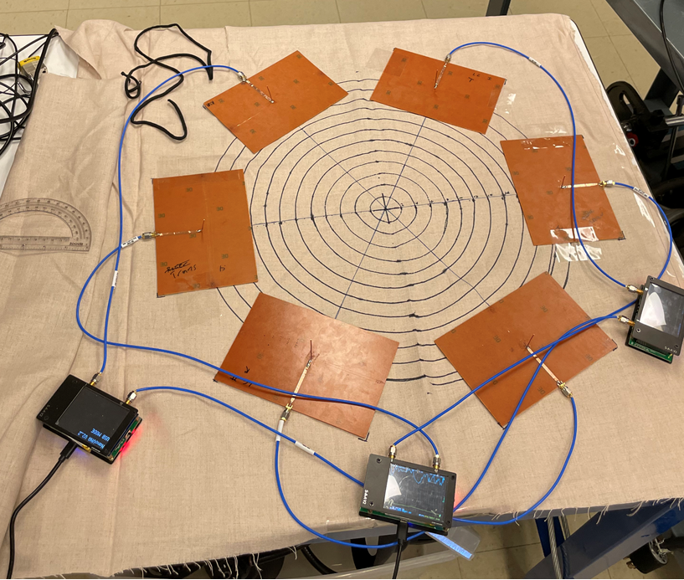

Slide 4
Data Collected
At three distinct frequencies:
S11 – ratio of signal transmitted by antenna 1 to signal received by antenna 1 – how much was reflected
S21 – ratio of signal transmitted by antenna 1 to signal received by antenna 2 – how much of the signal made it across the circle
This information as collected for approximately 40 different known locations of the can at different radii and angles
Dataset forms a set of 6 values that the VNA’s should read if the can is at one of those locations

Slide 6
An Ideal Approach
Define 6 continuous 2-D functions over the area of the circle to fit the data points and create smooth contours between them
Upon receiving 6 new datapoints for an unknown location, identify the location where each datapoint best fits the contours of the 2-D functions
Ideally, with perfect data, the S11 and S21 readings from each VNA should predict two points, and one point should be common to all three VNA readings

Slide 7
In practice
Data far from ideal
Sensitivity to environmental variables
Measurement resolution
Antenna construction
Matlab AI toolbox returned highly inconsistent, very incorrect results

Slide 8
Approach Used
Discrete approximation of the 6 continuous functions
All 6 readings for each known point were summed
When 6 readings are received from an unknown point, the sum of those measurements is compared to the list of sums of measurements associated with a known point, and a deviation is calculated
Yields an ordered list of known locations that the can is most likely near
Guessed location is an average of the top three nearest known locations, weighted by their deviation
Best of top three predictions typically accurate to about 5 cm – half the radius of the can

Slide 9
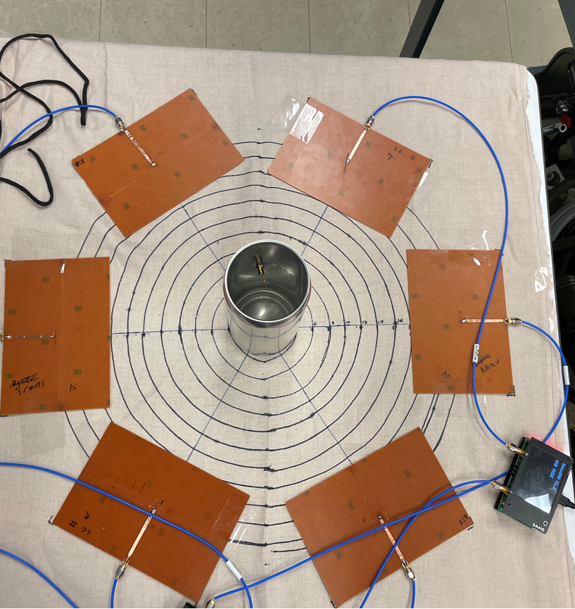

Slide 10
Extended approaches
The same system, split into three components to consider values from each antenna separately
Eschews the noise resistance of summing all 6 measurements
When noise is controlled, offers far more powerful
Addition of phase data
Relationship much harder to predictively model, but likely quite interesting
Weighting importance of known datapoints
i.e. taking data that matches a location directly between a transmit/receive pair to be more valuable than data corresponding to the periphery of transmit/receive pair

